Slide 1
18. NumPy - Indexing
Indexing Operation in NumPy Arrays
https://www.youtube.com/watch?v=bFv66_RXLb4

Slide 2
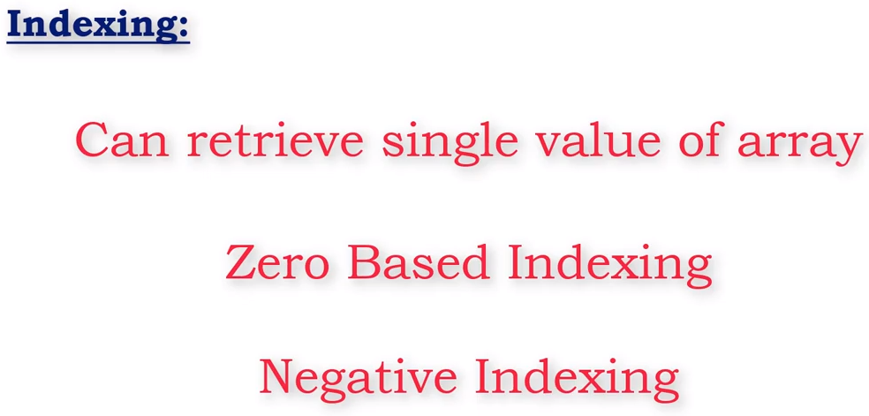

Slide 3

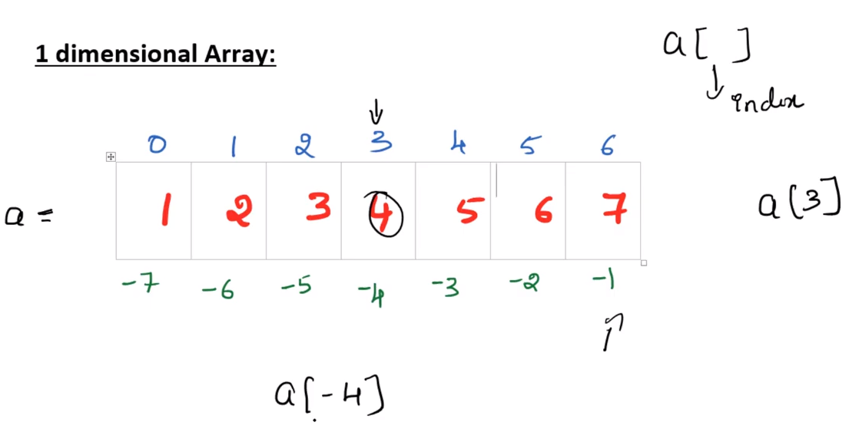
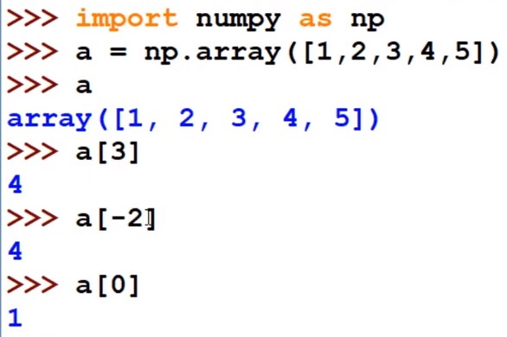

Slide 4
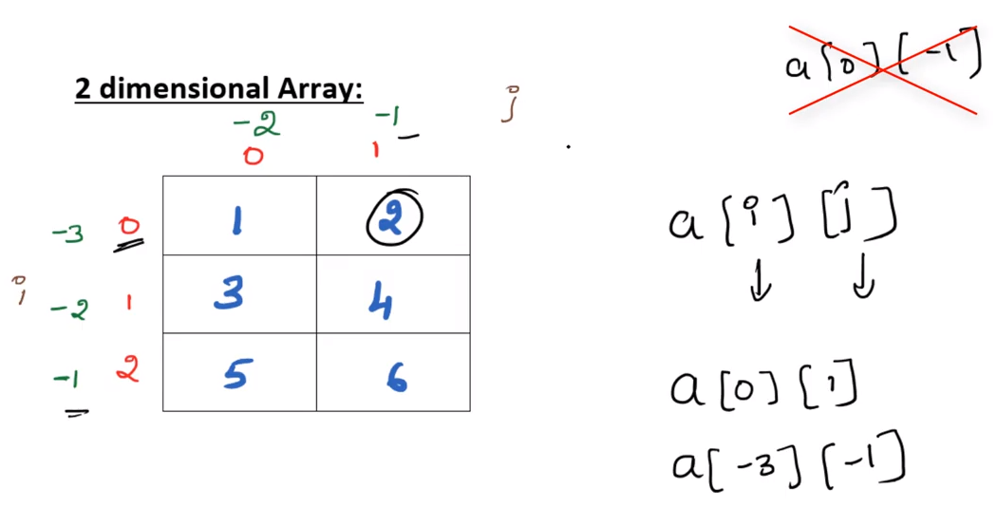
Don’t mix +ve and –ve indexing. Either both +ve (or) both –ve.

Slide 5
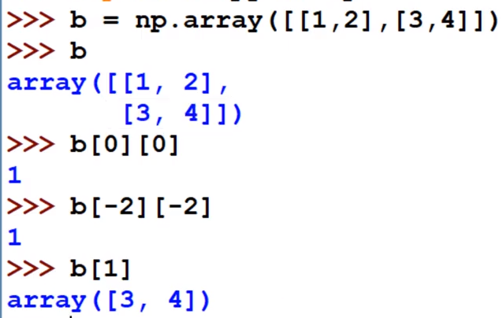

Slide 6
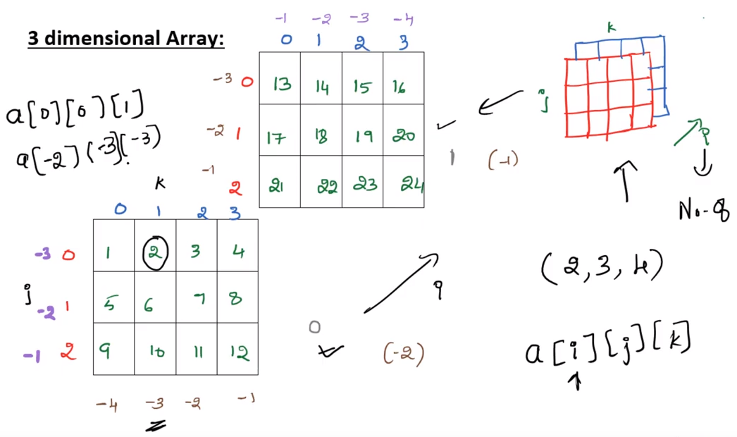

Slide 7
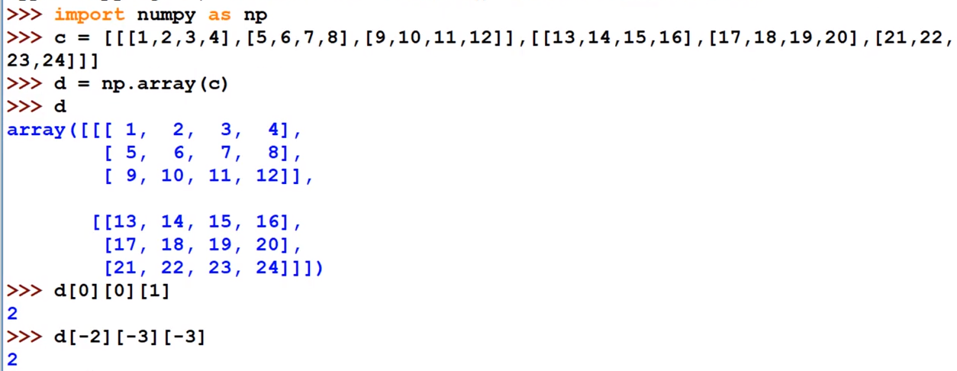

Slide 8
